Slide 1

Inheritance
Prepared by:
Raj Prasad Shrestha
Lecturer/Tutor at HCK

Slide 2
Agenda
What is Inheritance?
Inheritance in Java
Types of Inheritance in Java
Multiple Inheritance support in Java
super keyword in Java
The instanceof Operator
Advantages of Inheritance
“IS-A” vs “HAS-A” relationship
Object Class in Java

Slide 3
Concept of Inheritance
Inheritance can be defined as the process where one class acquires the properties (methods and variables) of another class.
The class which inherits the properties of other is known as subclass (derived class, child class) and the class whose properties are inherited is known as superclass (base class, parent class).

Slide 4
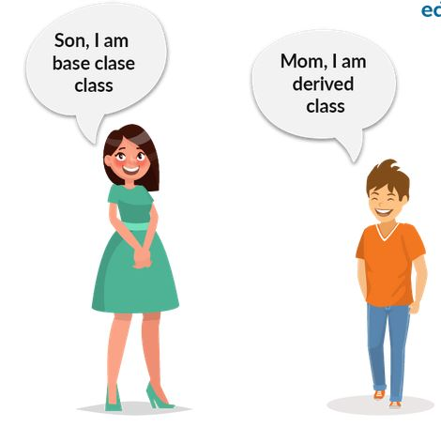
Ref: https://www.edureka.co/blog/inheritance-in-java/

Slide 5
Inheritance in Java
Using the keyword extends
With the use of the extends keyword among classes, all the properties of the superclass (also known as the ParentClass or Base Class) are present in the subclass (also known as the Child Class or Derived Class)

Slide 6
Syntax:
public class SuperClass{
….
}
public class SubClass extends SuperClass{
….
}

Slide 7
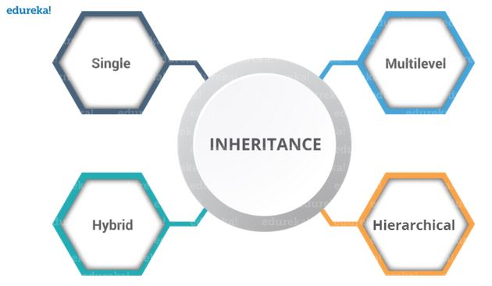
Types of Inheritance in Java
“IS-A” relationship between classes.
Ref:https://www.edureka.co/blog/inheritance-in-java/

Slide 8
Single Inheritance
In single inheritance, one class inherits the properties of one parent class.
Animal
SuperClass
IS A
Dog
SubClass
Dog “IS A” Animal.

Slide 9
Multi-Level Inheritance
When a class is derived from a class which is also derived from another class, i.e. a class having more than one parent class but at different levels, such type of inheritance is called Multilevel Inheritance.
Animal
IS A
Dog
IS A
Puppy

Slide 10
Hierarchical Inheritance
When a class has more than one child classes (subclasses) or in other words, more than one child classes have the same parent class, then such kind of inheritance is known as hierarchical.
Animal
IS A
IS A
IS A
Dog
Cat
Rabbit

Slide 11
Hybrid Inheritance
Hybrid inheritance is a combination of two or more types of inheritance.
Animal
Hierarchical Inheritance
IS A
IS A
IS A
Dog
Cat
Rabbit
Single Inheritance
IS A
Puppy

Slide 12
Multiple Inheritance Support in Java
Multiple inheritance refers to the process where one child class tries to extend more than one parent class.
SuperClass1
SuperClass2
Subclass
Note: Multiple inheritance is not supported in Java

Slide 13
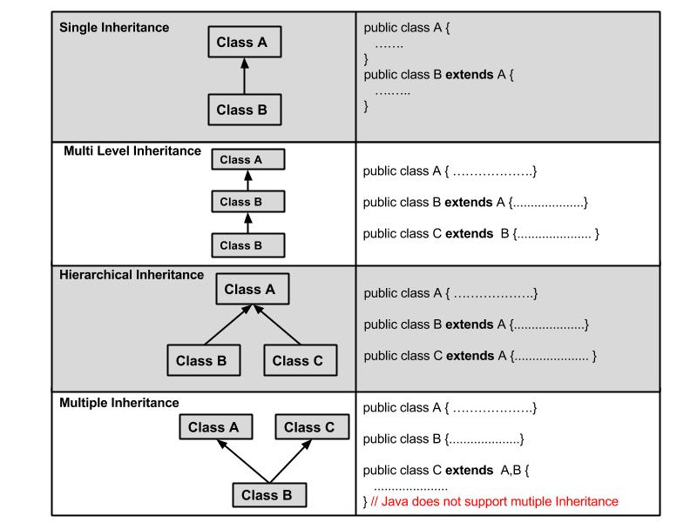
C

Slide 14

Some Rules of Access Modifer in Java

Slide 15
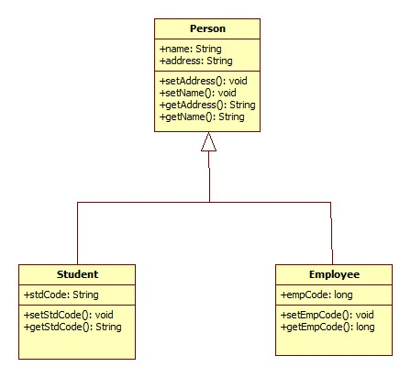
SuperClass
Demo
Methods
Instance Variables
IS A
SubClass
Figure: Class Diagram of Hierarchical Inheritance

Slide 16
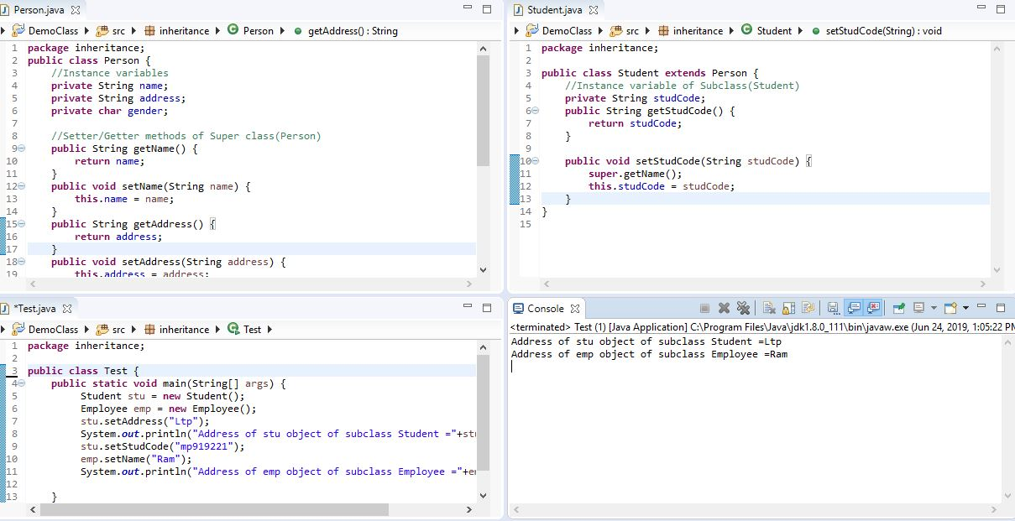
Subclass Student
SuperClass Person
Member of Student class
name | Inherited from Person class
address | Inherited from Person class
gender | Inherited from Person class
studCode | Defined in Student class
Getter/Setter methods of name,address and gender | Inherited from Person class
Getter/Setter methods of studCode | Defined in Student class

Slide 17
Super keyword in Java
It is a reference variable that is used to refer immediate parent class object.
Usage of super keyword:
1. super is used to invoke variable of Parent class
super.parentClassVariable;
super is used to invoke constructor of Parent class
super( );
3. super is used to invoke methods of Parent class
super.methodName( );

Slide 18
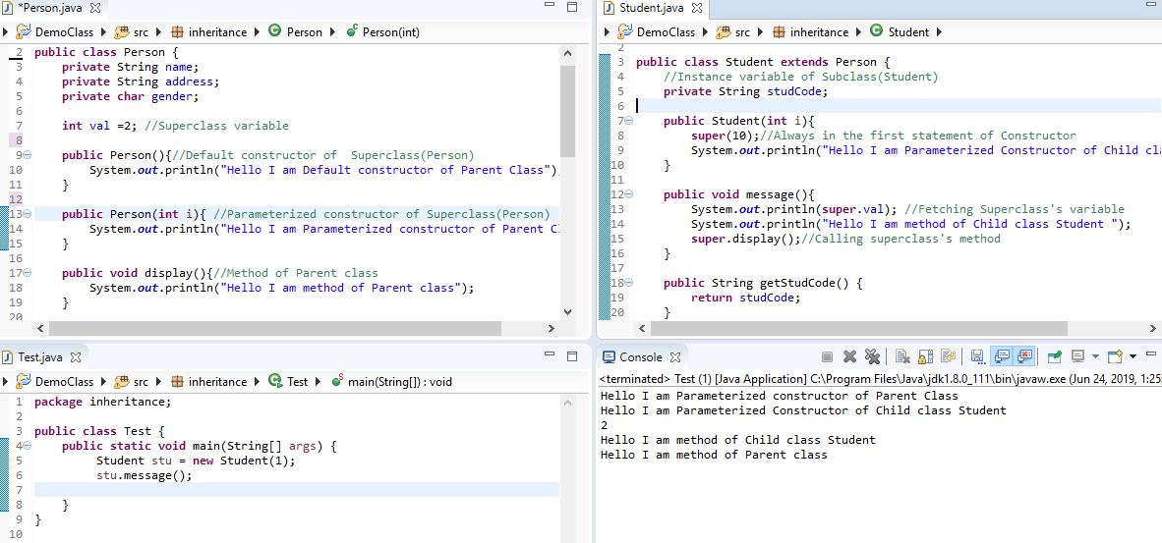
Calling the parameterized constructor of Superclass(Person) from Student class
Calling the Person’s class variable i.e val
Calling the Person’s method (display()) from Student class

Slide 19
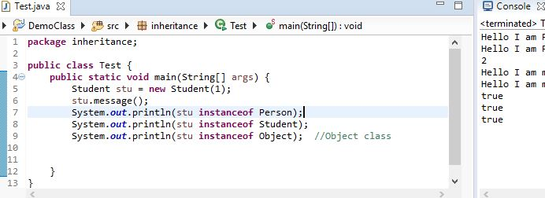
instanceOf Operator in Java
The java instanceof operator is used to test whether the object is an instance of the specified type (class or subclass or interface).
Syntax:
objectName instanceOf ClassName
Note: It returns Boolean value either true or false.

Slide 20
Advantages of Inheritance
Avoiding code duplication
Easier maintenance
Extendibility

Slide 21
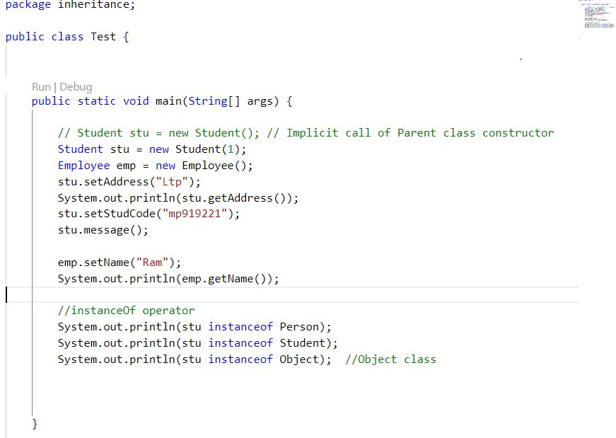
“IS-A” Vs “HAS-A” Relationships
IS-A = Inheritance
Has-A means an instance of one class “has a” reference to an instance of another class or another instance of same class.
Test class “HAS” student class object(i.e stu)
Test class “HAS” employee class object(ie. emp)

Slide 22
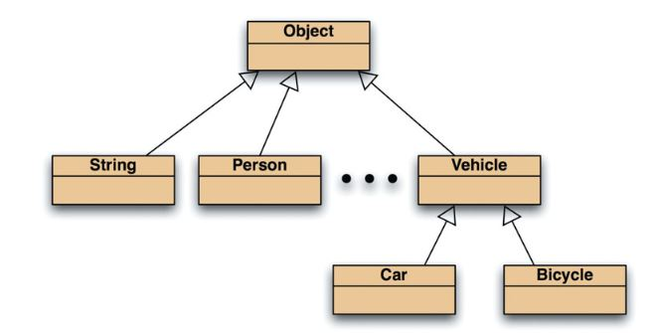
Object Class in Java
The Object class is the parent class of all the classes in java by default.
In other words, it is the topmost class of java.

Slide 23
References
  https://goalkicker.com/JavaBook/
  https://www.edureka.co/blog/inheritance-in-java/
  https://www.javatpoint.com/object-class
  https://www.youtube.com/watch?v=bn3zKuU6gwI&list=PLGwb7xZHg-oMzLwqeyvdI7R_OWVMQFyce

